Slide 1
SBI - Video Analytics
Sourabh Kumar Janghel

Slide 2
HELLO!
I am Sourabh Kumar Janghel
This Presentation contains detailed representation of the POC submitted at Techgig for SBI Hackathon .
You can find me at sourabh.kumar.janghel@outlook.com

Slide 3
Description Of Solution
1
Description of what the Team has tried to build

Slide 4
THE PROCESS
People Spatial Analysis & movement Tracking
Face Detection and Verification with Facial Analysis
Weapon, Fire, Theft Detection

Slide 5
ROADMAP – People Detection
Load the video
Get People identified from the video frame using a SSD (Single Shot Detector) with a MobileNet architecture
Once the co-ordinates are obtained by our SSD, the tracker computes the centroid (center) of the box
1
3
5
2
4
6
Read Frames from videos
centroid tracker computes the centroid of the bounding boxes
Then an unique ID is assigned to every particular object deteced, for tracking over the sequence of frames.

Slide 6
ROADMAP – Face Detection
Load the video and read the Frames
Reads a directory containing faces of –ve people and +ve people to be matched against
Extract facial attribute analysis – Emotion, Age, gender
1
3
5
2
4
6
Uses opencv detector to detect faces in the frames
Does face matching and verification using VGG-Face Model using cosine-similarity
Freeze the face frame for 5 frames and then save the results

Slide 7
ROADMAP – Object Detection
Upload the document to azure and get a url
Detects currently Fire and weapons in Frames
Get results from azure API
1
3
5
2
4
6
Run object detection custom model trained on YOLOv5
Use Azure Video Indexer to upload a video to azure
Clean the result to get detections and save results

Slide 8
Architecture
2
High-level implementation / Solution diagram

Slide 9
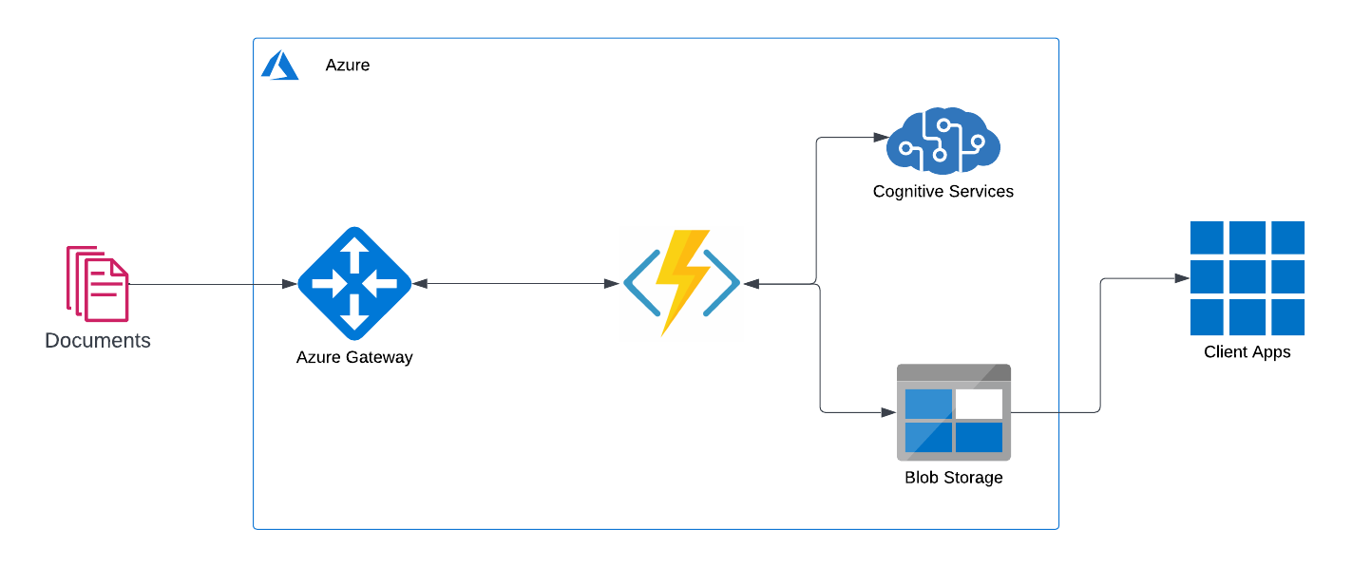

Slide 10
Tech Stack
3
Tools, Technology Stack (including the APIs consumed), and framework details

Slide 11
TECH STACK ANALYSIS
Tools
Python 3.9
APIs
Azure Functions
Azure Video Indexer
Azure Containers
Storage
YOLOv5
Framework

Slide 12
Algorithms
4
The algorithms / machine learning models that have been used in the Hackathon prototype

Slide 13
USED Algorithms
Deepface
Tensorflow
PyTorch
Opencv
dlib
Pillow
imutils
scipy
azure-storage-blob

Slide 14

A PICTURE IS WORTH A THOUSAND WORDS
A complex idea can be conveyed with just a single still image.
Namely making it possible to absorb large amounts of data quickly.

Slide 15
Output
5
Test cases and corresponding processed output file(s) along with the output time

Slide 16
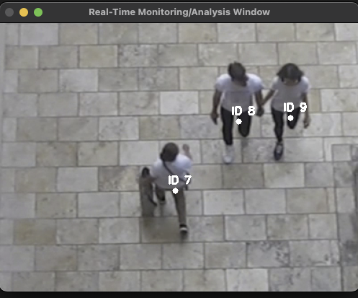
Count of People

Slide 17
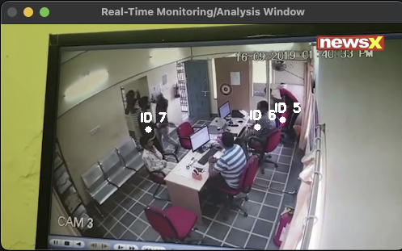
Time taken for activity in premises

Slide 18
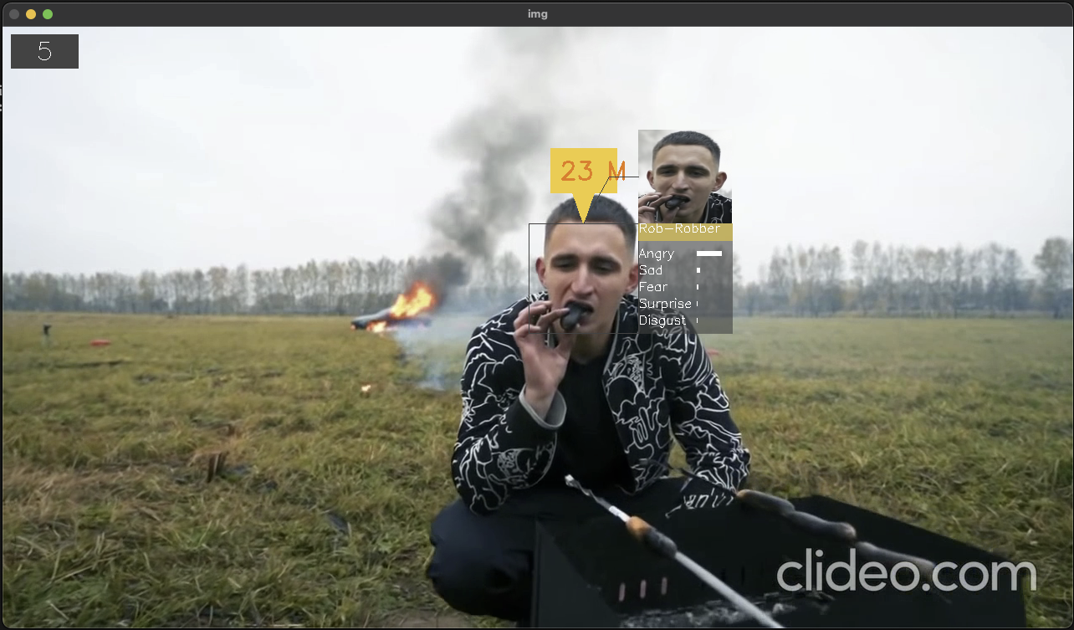
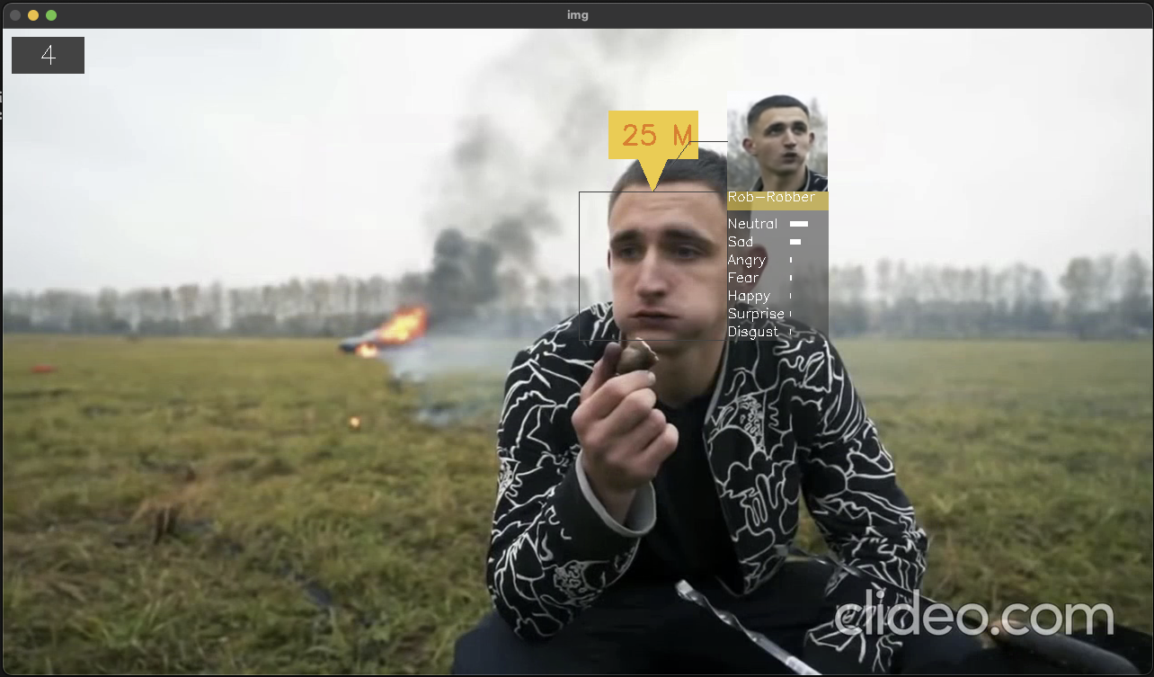
Identification of known miscreants

Slide 19
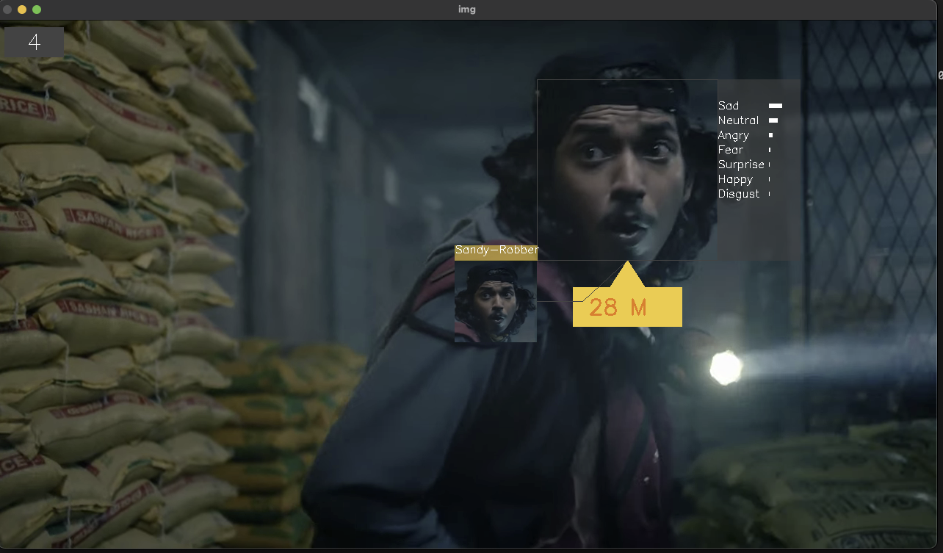
Suspicious Activities

Slide 20
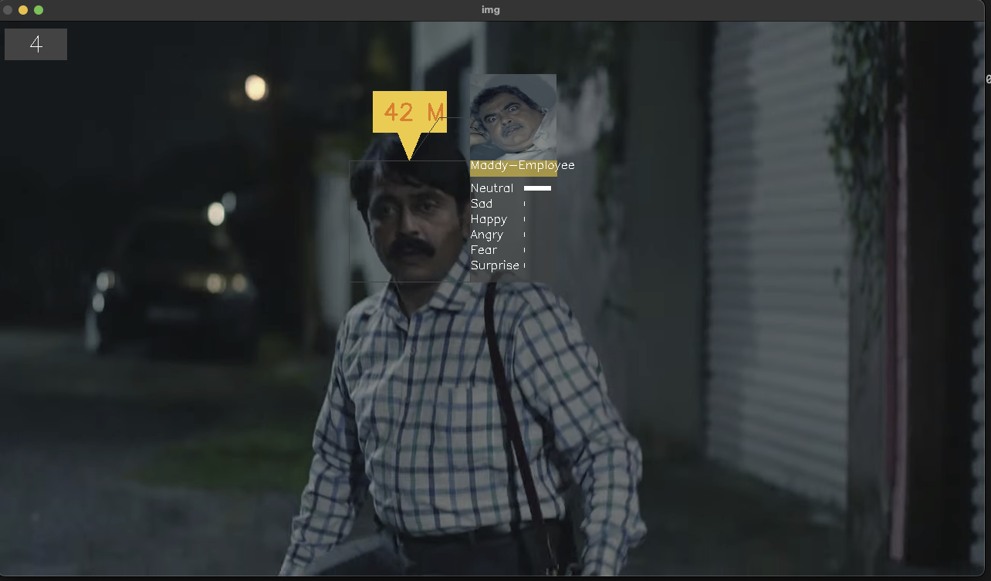
Identification of known facilitators

Slide 21
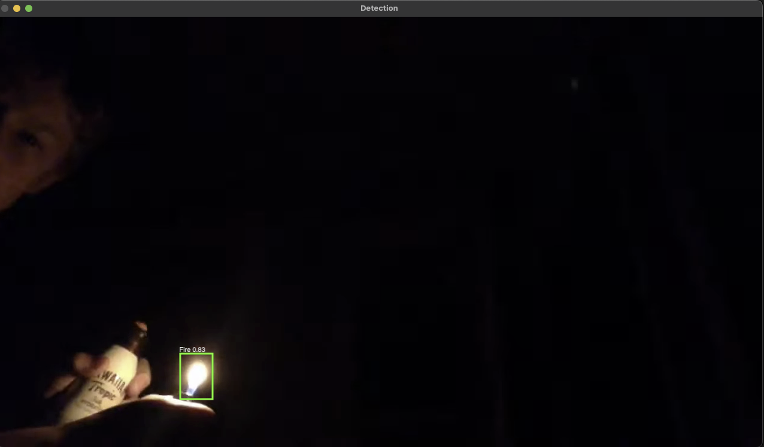
Fire / Theft related incident taking place

Slide 22
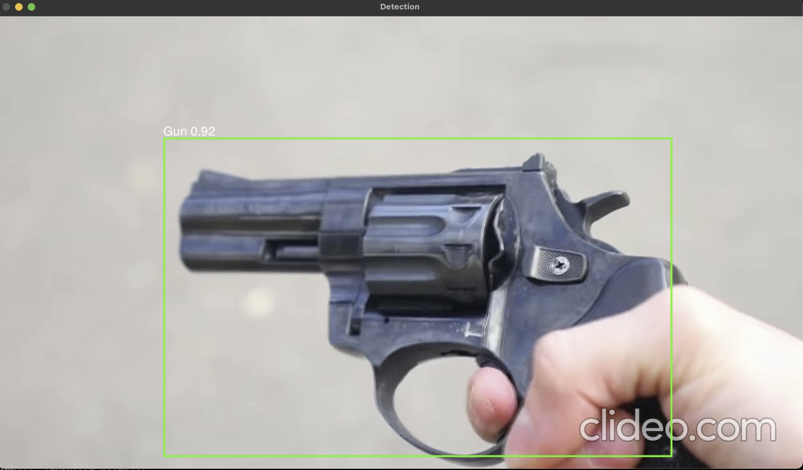
Hazardous Objects being brought into the premises

Slide 23
Summary
6
A write-up on why your application /solution should be considered

Slide 24
Why the solution should be considered?
The below points can be considered for my submission:
Works well for noisy videos.
Custom Object Detection Models trained using YOLOv5 which is lightweight and fast.
SSD seasoned with a MobileNet should theoretically result in a faster, more efficient object detector.
MobileNet, is a DNN designed to run on resource constrained devices. For example, mobiles, ip cameras, scanners etc.
Azure Functions for parallel processing of videos and scaling
lightweight face recognition and facial attribute analysis without any significant training.
Training Pipeline provided thus A better version of the model can be trained given more data can be collected specific to bank interior videos.

Slide 25
Scaling
7
Ability to scale-up in enterprise grade environment

Slide 26
The Solution Can be dockerised and deployed as a HTTP Azure function
AZURE Functions
100% Scalable
That’s a easy serverless way of running the solution on cloud
instances of the Functions host are dynamically added and removed based on the number of incoming events.
Automatically scales based on demand using pre-warmed workers, which run applications with no delay after being idle, runs on more powerful instances, and connects to virtual networks
Total success!

Slide 27
Video Demo
Please Find the Link of the video here.

Slide 28
THANKS!
Any questions?
You can find me at
sourabh.kumar.janghel@outlook.com
@sourabhkumarjanghel

Slide 29
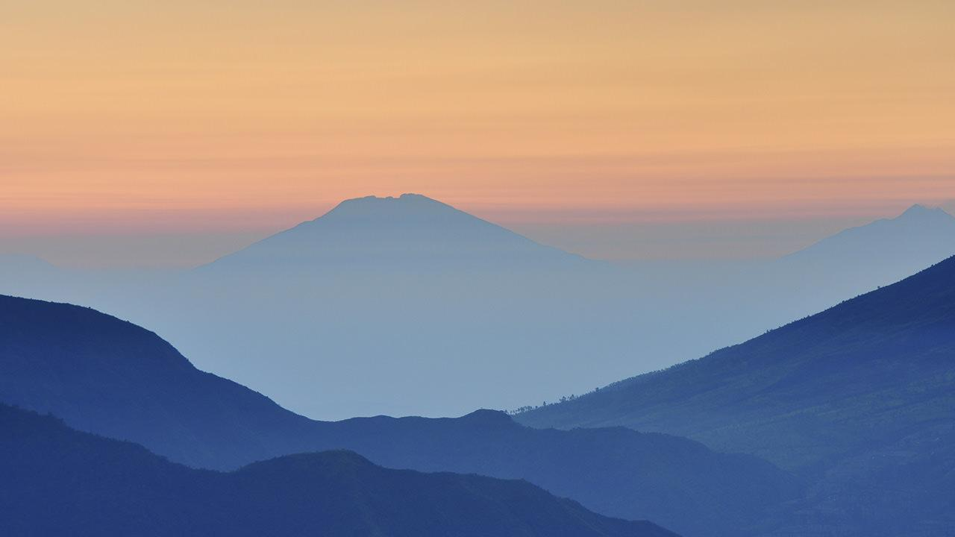
WANT BIG IMPACT?
USE AZURE CLOUD!

